Slide 1
THE ENVIRONMENT
TWO PROBLEMS
I know that because of lockdown many people may have thought that we
do not need to worry about global warming but it is still going on.
I know that at this time it is very difficult to think about these two major problems
at the same time.
We have to act now. We can’t go back to how things were.
PART 1 pollution

Slide 2
CARS
Lots of people are using some sort of machine that is producing carbon dioxide.
Due to social distancing lots of people are using their car to keep social distancing instead of public transport and so it’s still affecting in the world. We need to change now more than ever.
Now so many people use cars every day it is getting out of hand; over 53% of the UK use a car each day.
With too much carbon dioxide all the polar ice is melting. Polar ice deflects some of the sun’s heat back in to space but with all the polar ice melting it enables more of the sun’s heat gets in.

Slide 3
It is fun without a car
Being in the car for hours a day all the time can be a bit boring. Have fun, get out and exercise - go for walks, have a picnic or play in your garden. Also it is good for you if you want to be fit and healthy. It is amazing outside so go and explore the world with your friends.
Everybody can find some way to have fun out side from bird watching to swimming in a lake. But to be environmentally friendly we should try to walk there.

Slide 4
Flying
Year after year we cause so much carbon dioxide by flying but now we’re flying less because of lockdown.
But we are still using planes on the upside, in April 2020 flying had decreased by 40% brilliant! But it is still a lot of carbon dioxide.
And after the end of lock down we might go back to normal.
Will it go back to normal?
https://www.forbes.com/sites/tamarathiessen/2020/04/01/40-percent-less-flights-worlwide-air-travel-restrictions/#10da0cfa6079

Slide 5
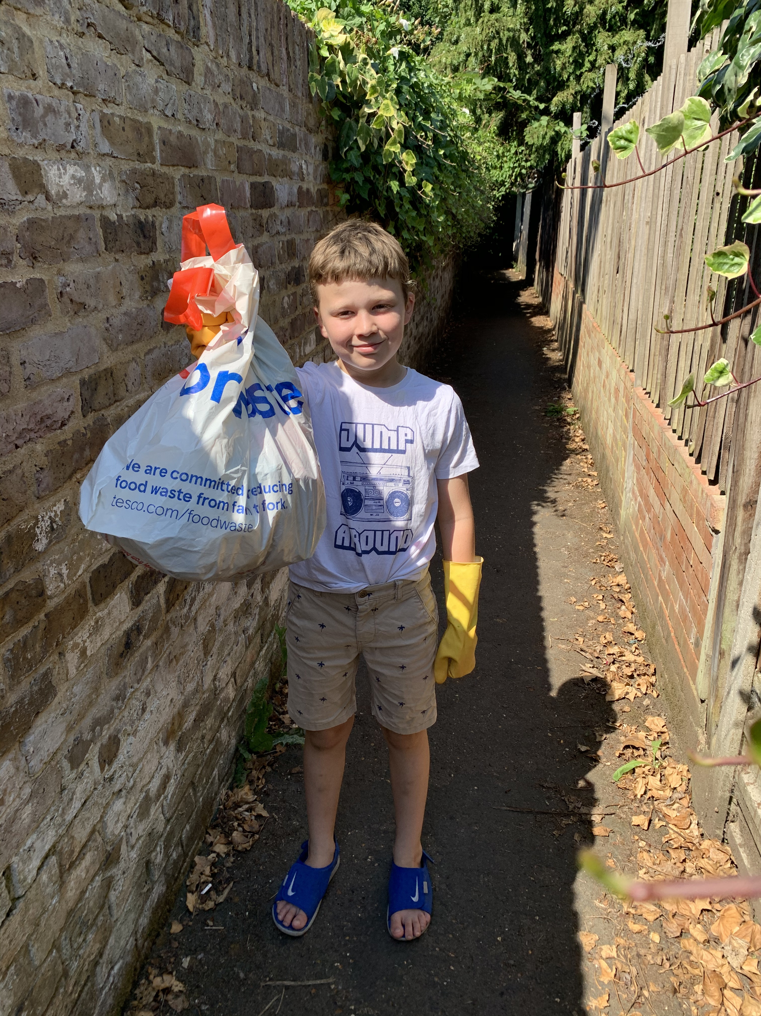
Litter
Litter is bad in many ways. It can get caught around animals necks, they can get stuck in it and they can eat it which could kill them and this is not good at all.
So if you find a bit of litter lying around please pick it up. Also don’t litter yourself. Here are some examples of litter we found just near Deer Park School.
Part 2 litter

Slide 6
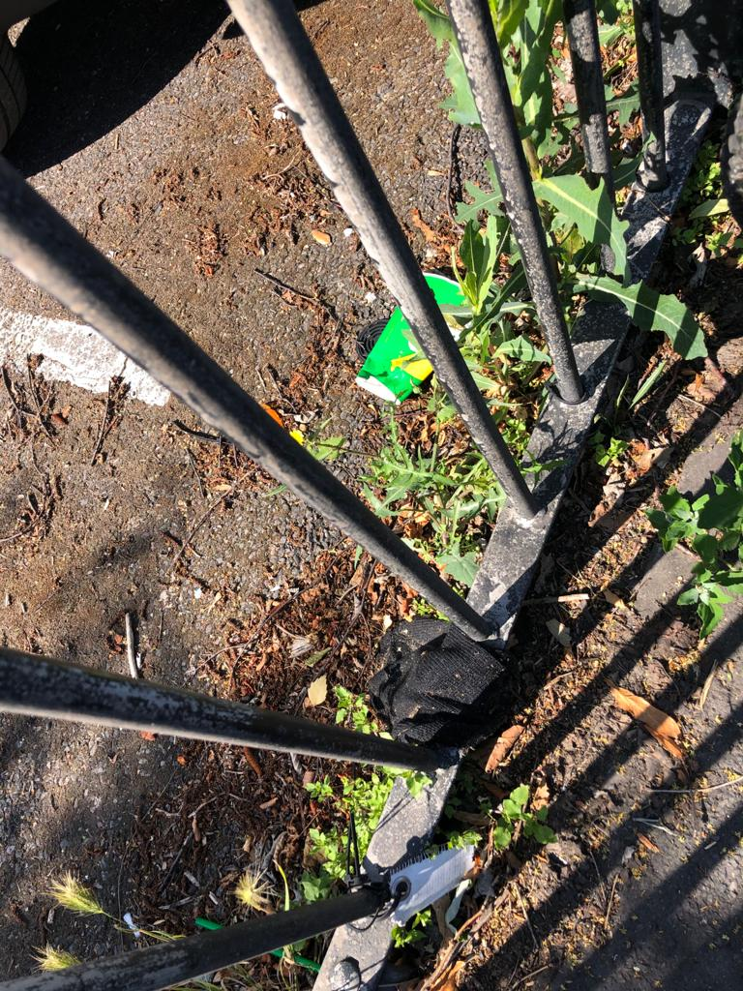
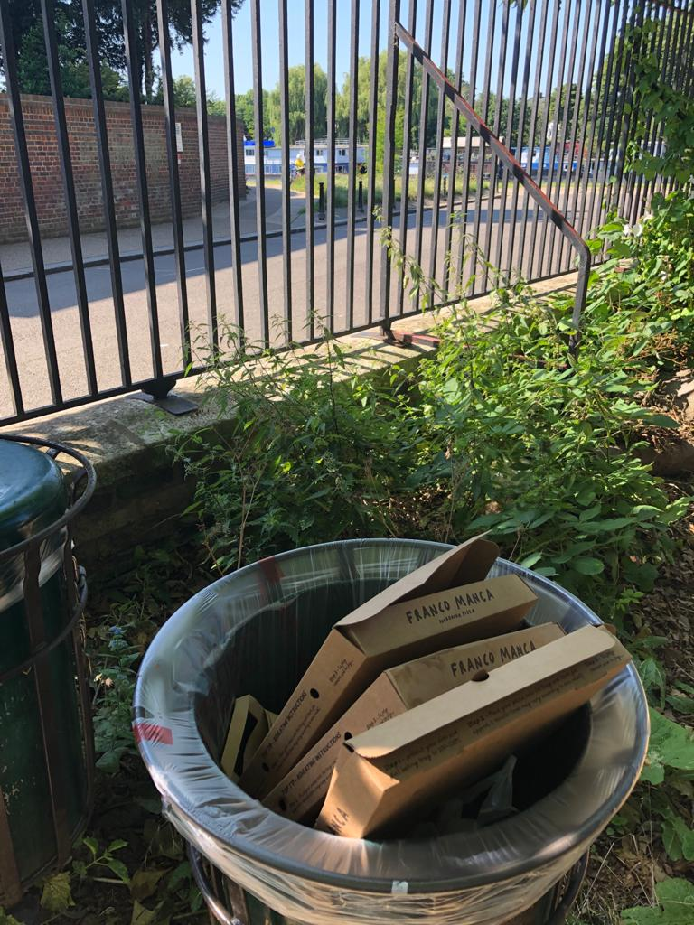
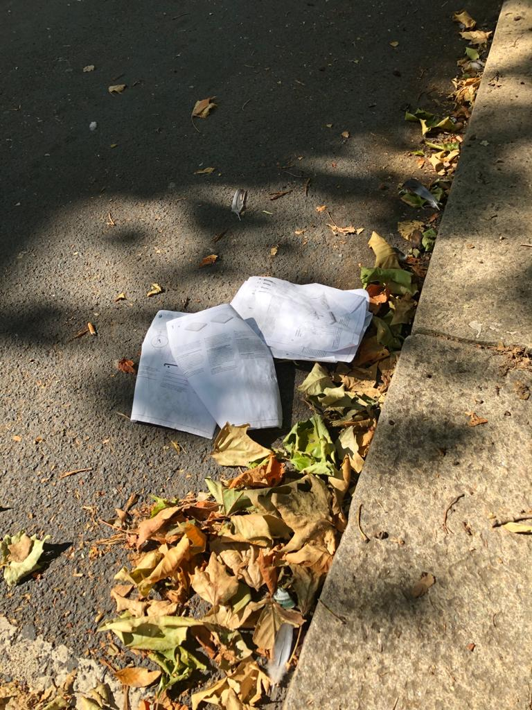

Slide 7
I’m going to show you a quick video on why litter is dangerous to animals and how it could be dangerous to humans.

